Slide 1
Introduction to Compiler
Presented By:
Dr. Bhawana Tyagi

Slide 2
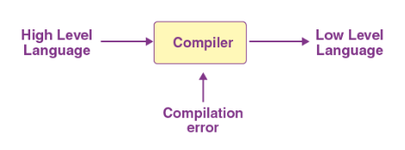
Compiler

Slide 3
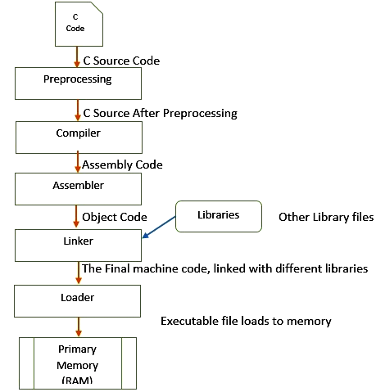
Steps for Execution

Slide 4
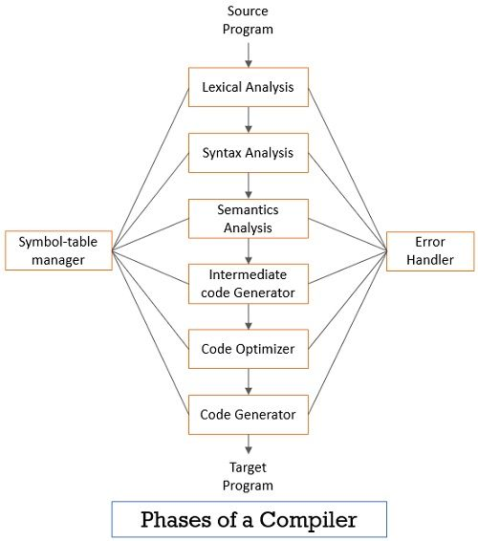

Slide 5
LLVM (Low Level Virtual Machine)
It is an open source compiler infrastructure that provides a set of tools and libraries for building compilers, debuggers, and other software development tools.
It was originally developed at the University of Illinois at Urbana-Champaign and is now maintained by the LLVM Foundation.
It consists of a set of modular and reusable compiler and tool chain technologies that can be used to build a wide range of compilers and other tools.
It includes a compiler front end, which translates high-level programming languages into intermediate representations (IRs); a compiler back end, which translates IRs into machine code that can be executed on a specific target architecture
It can be used to build compilers for a wide range of programming languages, including C, C++, and Fortran, as well as other languages such as Swift and Rust.

Slide 6
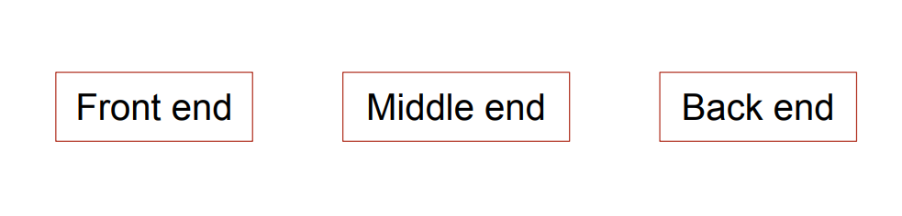
LLVM Compilation Infrastructure

Slide 7
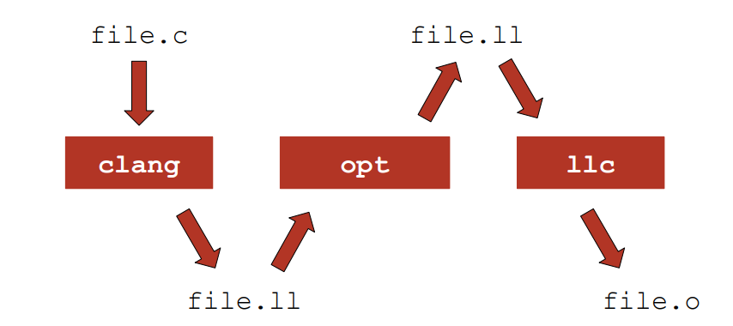
LLVM Compilation Infrastructure

Slide 8
Lexical Analysis
Source program is scanned to read the stream of characters and those characters are grouped to form a sequence called lexemes which produces token as output.
Token: Token is a sequence of characters that represent lexical unit, which matches with the pattern, such as keywords, operators, identifiers etc.
Lexeme: Lexeme is instance of a token i.e., group of characters forming a token.
Pattern: Pattern describes the rule that the lexemes of a token takes. It is the structure that must be matched by strings.
Once a token is generated the corresponding entry is made in the symbol table.

Slide 9
Lexical Analysis
Lexeme | Token
a | Identifier
= | Assignment Operator
b | Identifier
+ | Operator
c | Identifier
* | Operator
b | Identifier
+ | Operator
c | Identifier
* | Operator
b | Identifier
+ | Operator
c | Identifier
Example: Input String
a=b+c*b+c*b+c

Slide 10
Syntax Analysis
It converts the tokens produced by lexical analyzer into a tree like representation called parse tree.
Obtain tokens from the lexical analyzer.
Checks if the expression is syntactically correct or not.
Report all syntax errors.
Construct a hierarchical structure which is known as a parse tree.

Slide 11
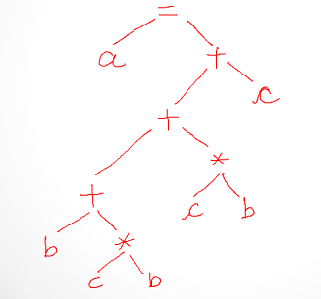
Syntax Analysis
a=b+c*b+c*b+c

Slide 12
Semantic Analysis
Semantic analysis checks the semantic consistency of the code.
It uses the syntax tree of the previous phase along with the symbol table to verify that the given source code is semantically consistent.
It also checks whether the code is conveying an appropriate meaning.
Semantic Analyzer will check for Type mismatches, incompatible operands, a function called with improper arguments etc.

Slide 13
Intermediate Code Generation
The compiler produces intermediate code for the target machine following the completion of the semantic analysis step.
It is necessary to create this intermediate code in a way that makes it simple to convert it into the target machine code.

Slide 14
Intermediate Code Generation
a=b+c*b+c*b+c
-------------------------------------
T1=c*b
T2=c*b
T3=b+T1
T4=T3+T2
T5=T4+c
a= T5

Slide 15
Code Optimization
Code optimization phase gets the intermediate code as input and produces optimized intermediate code as output.
It results in faster running machine code.
It can be done by reducing the number of lines of code for a program.
This phase reduces the redundant code and attempts to improve the intermediate code so that faster-running machine code will result.

Slide 16
Code Optimization
a=b+c*b+c*b+c
-----------------------------------
T1=c*b
T2=b+T1
T3=T2+T1
T4=T3+c
a= T3

Slide 17
Code Generation
Code generation is the final phase of a compiler.
It gets input from code optimization phase and produces the target code or object code as result.

Slide 18
Code Generation
Example: a = b + 60.0
----------------------------------------------
MOV b, R1
MULF #60.0, R2
ADD R2, R1
Store R1,a

Slide 19
Error Handling
In the compiler design process error may occur in all the below-given phases:
Lexical analyzer: Wrongly spelled tokens
Syntax analyzer: Missing parenthesis
Intermediate code generator: Mismatched operands for an operator
Code Optimizer: When the statement is not reachable
Code Generator: When the memory is full or proper registers are not allocated
Symbol tables: Error of multiple declared identifiers.

Slide 20
Symbol Table
A symbol table contains a record for each identifier with fields for the attributes of the identifier.
This component makes it easier for the compiler to search the identifier record and retrieve it quickly.
The symbol table also helps you for the scope management.
The symbol table and error handler interact with all the phases and symbol table update correspondingly.

Slide 21
Thank You

